Slide 1
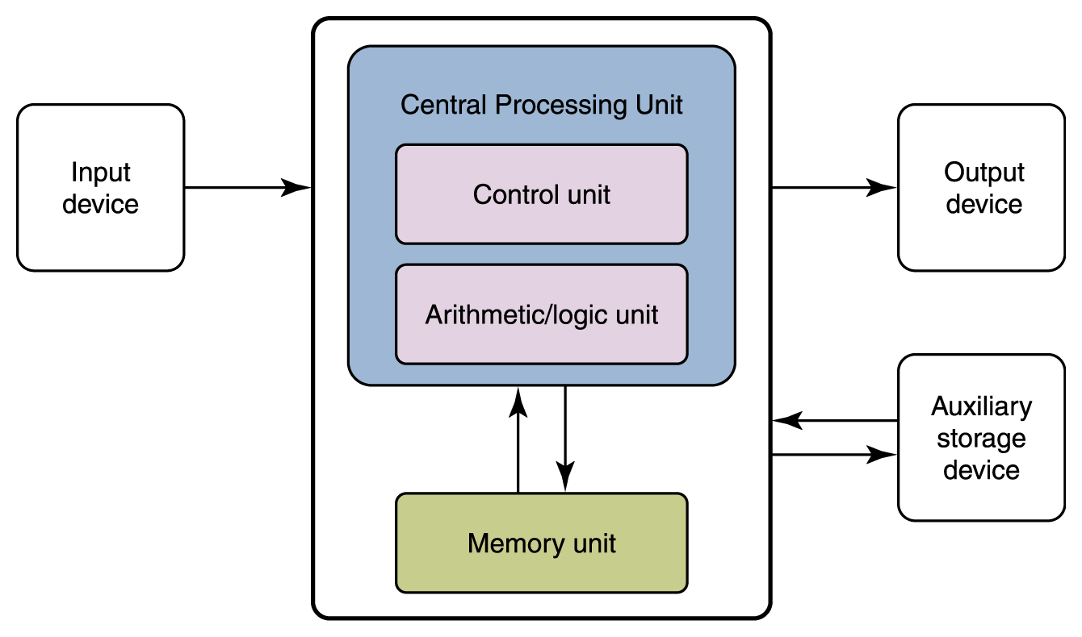
The von Neumann architecture
John von Neumann, mid-1940’s
Standard architecture for all mass produced computers since
Fundamental ideas
Stored program concept
Same memory used for both data and programs
Linearly addressed memory
Each memory location gets a unique, sequential numeric address
Memory addresses independent of content
A memory location is always addressed the same way, regardless of what it contains
Notes:
Figure from page 125 of Computer Science Illuminated, Third Ed., by Nell Dale and John Lewis (Jones and Bartlett, 2007)

Slide 2
Components of the CPU
Arithmetic logic unit (ALU)
Holds data temporarily and executes instructions
Control unit (CU)
Interprets and manages the execution of instructions
Fetch-execute instruction cycle
Mostly moves instructions and data around
Bus interface unit
Memory management unit
I/O interface
*
Notes:
The primary source for the material in this presentation (including figures and illustrations) is The Architecture of Computer Hardware, Systems Software, & Networking: An Information Technology Approach, 4th edition (plus supplementary materials) by Irv Englander (John Wiley & Sons, 2009).
‹#›

Slide 3
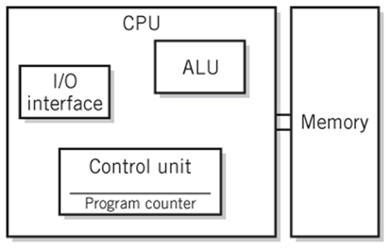
Components of the CPU
The central processing unit (CPU) is the heart of the computer, where all the instructions are managed and executed
It’s commonly divided into two primary components:
Arithmetic Logic Unit (ALU)
Control Unit (CU)

Slide 4
Arithmetic Logic Unit (ALU)
The arithmetic logic unit (ALU) temporarily holds data and executes instructions on that data
It’s important to realize that the ALU has very limited space for storing data
As such, it typically stores only the data on which the current instruction will be acting
The rest of the data, as we’ll see is stored in the computer’s memory

Slide 5
Control Unit (CU)
The control unit (CU) interprets and manages the execution of instructions
The process of executing an instruction is typically described as the fetch-execute instruction cycle
Most of what the CU does involves moving instructions and data around

Slide 6
Registers
Registers are an important subcomponent used throughout the CPU
Register list - all of the registers in the CPU
A register as an individual storage location within CPU used for one or more specific purposes
Registers are designed to hold binary values
As with the contents of memory, those bits are utterly meaningless without context
It’s the programmer’s job to ensure that a register’s contents are interpreted in the proper context (the data type)

Slide 7
Registers vs. Main Memory
However, they differ from memory in several important ways
There are a limited number of registers available to the CPU and each one holds only a few bytes
As such, there is significantly less storage available in registers than there is in memory
Most modern computers measure total register space in bytes, and memory space in gigabytes (billions of bytes)
Registers are typically treated as discrete units and accessed individually
Registers are not addressed like memory locations, they are manipulated directly by the CU
Each register is sized and hardwired for its assigned purpose(s)

Slide 8
Register Tasks
Registers are used for several different types of tasks within the CPU
Hold a small piece of data for processing
Hold a single instruction to be executed
Hold a single memory address to be accessed
Hold status info (bit-sized flags that indicated various yes-no states within the CPU)

Slide 9
Common Registers
A typical CPU contains several different registers for a wide variety of purposes
The ALU contains one or more accumulators
These are also known as general-purpose registers, since they can typically be used for a variety of purposes

Slide 10
CU Registers
The CU contains several special-purpose registers
The program counter (PC) is used to store the address of the next instruction to be executed
The instruction register (IR) is used to hold the instruction currently being executed
The memory interface unit typically uses two dedicated registers
The memory address register (MAR) is used to hold the address of the memory location currently being accessed
The memory data register (MDR) is used to hold the data being moved to or from the memory location whose address appears in the MAR

Slide 11
Buses
Physical path over which data and instructions are moved
CPU to memory – dedicated
Registers to registers – dedicated
CPU to peripherals – standard
PCI Express, IDE, SATA, USB, etc.
Collection of lines
Conductors – wires, traces, fibers
Categories
Data
Addressing
Control
Power

Slide 12
Characteristics of buses
Data line usage
Parallel
Serial
Direction
Simplex
Half-duplex
Full-duplex
Arrangement
Point-to-point
Multipoint/broadcast
Protocol
*
IT520 The CPU and Memory
‹#›

Slide 13
Buses
The operations performed by the CPU typically involve a great deal of movement of data and instructions
A bus is the physical path over which data and instructions are moved between components
Dedicated buses are those which are designed specifically as integral components of larger systems for specific purposes
A dedicated bus connects the CPU to memory
Other dedicated buses connect registers to one another
Standard buses are typically general-purpose buses that are designed to fulfill a variety of roles and connect differing devices which may not have existed at the time the bus was designed
Typically, standard buses are used to connect the CPU to its peripherals
PCI Express, IDE, SATA, USB are all examples of standard buses
A bus consists of a collection of lines
Each line is a conductor of some sort
Wires and traces are used to conduct electrical signals
In some systems, optical fibers are used to conduct signals consisting of pulses of light

Slide 14
Purpose
The lines of a bus are typically categorized by their intended purpose
Data lines carry the data being moved
Addressing lines are used to specify the destination of the data
Control lines are used to provide control and timing signals to devices along the bus
Power lines carry the power to supply the devices along the bus
Power lines are typically dedicated to their task, but other lines can be flexible and have different purposes under different circumstances

Slide 15
Protocol
Once all the characteristics and categories of a bus have been determined, they must be encapsulated in some sort of bus protocol
A bus protocol carefully specifies all the characteristics of the bus, including how each line is used, the format of the signals transmitted, and much more
It’s absolutely essential that all devices connected to a bus adhere strictly to the bus protocol, or the bus will simply not be able to function

Slide 16
Characteristics of Memory
The most important characteristic of memory is how it can be used
Some types of memory can be used for both reading and writing
Random access memory (RAM)
Cells can be accessed in any order needed
RAM is typically volatile, which means once power is lost, so are the contents of RAM
Other types of memory are only able to be read and are written only once (or very rarely)
Read-only memory (ROM)
There are different types of ROM, some are constructed with specific contents, others can be written to after installation, but writing is very slow and power intensive and therefore a rare operation
All types of ROM are non-volatile, which means that the contents are retained even in the absence of power
Other characteristics can impact the choice of memory for specific applications
Different memory modules may be constructed with different access speeds
Some applications require faster (and typically more expensive) memory
Power consumption and heat generation can differ among types of module
Laptops emphasize battery life and have trouble dissipating heat effectively
Bit density is measured in terms of the bits that can be stored per square centimeter of medium
Cost can vary widely for different types of memory based on supply and demand as well as manufacturing costs

Slide 17
Memory Unit
Since the space in the registers is extremely limited, the CPU must work very closely with the memory unit
The memory unit consists of several individual cells (or memory locations)
Each of the cells is uniquely identified by its own numeric address
Each of the cells stores the same number of bits (typically a multiple of 8)

Slide 18
Types of RAM
There are two general types of RAM in widespread usage: dynamic and static
Dynamic RAM (DRAM) is commonly used for the main memory unit
It tends to be cheap, requires less power, generates less heat, and provides a higher bit density
The downside is that it requires frequent refreshing to maintain its contents
This necessitates additional circuitry
Static RAM (SRAM) is typically reserved for special applications such as cache memory
It’s 2-3x faster than DRAM, but also more expensive (per unit of storage), generates more heat and offers significantly lower bit densities
It doesn’t need to be refreshed periodically, but loses its contents when power is lost

Slide 19
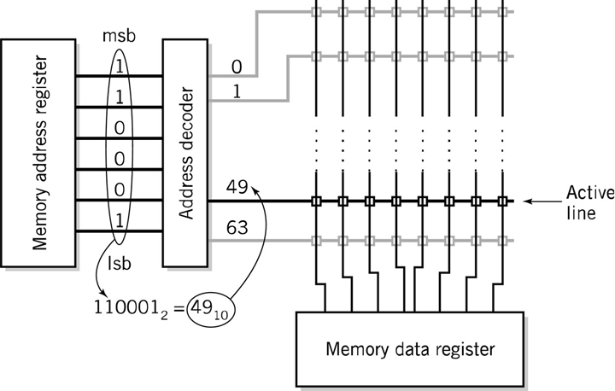
Operation of Memory
Uniquely addressed cells, each holding the same number of bits
Accessed via MAR and MDR of memory interface unit

Slide 20
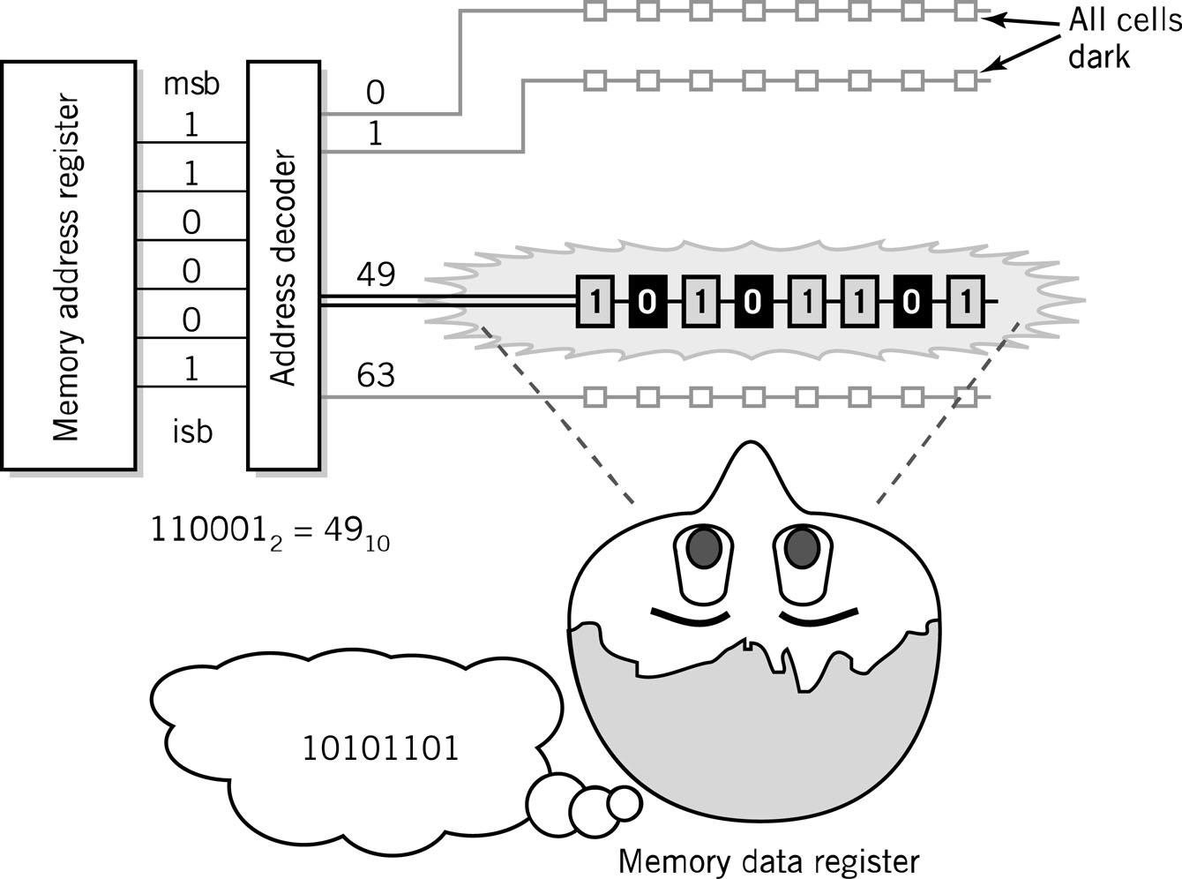
Visual Analogy of Memory
Copyright 2010 John Wiley & Sons, Inc.
7-‹#›

Slide 21
Capacity of Memory
There are two architectural limitations of the capacity of the memory unit
The size of the MAR (in bits) determines the number of unique addresses available
A MAR size of k bits provides 2^{k} unique addresses
16 bits provides 65,536 addresses (64K)
32 bits provides 4,294,967,296 addresses (4GB)
64 bits provides 18,446,744,073,709,551,616 addresses (16EB)
Kilo, mega, giga, tera, peta, exa, zetta, yotta
Traditionally, successive powers of 1024 or 1000, depending upon usage
Moving toward powers of 1000 exclusively

Slide 22
The characteristics of memory
Read-write or read-only
Random access memory (RAM) – volatile
Read-only memory (ROM) – non-volatile
Access speed
Power consumption
Heat generation
Bit density
Cost
Dynamic vs. static RAM
Dynamic RAM used for main memory unit
Cheaper, less power, less heat, higher density, requires refresh
Static RAM used for cache memory
Faster, more expensive, lower density, no refresh required
*

Slide 23

The Memory Hierarchy
Generally speaking, faster memory is more expensive than slower memory.
To provide the best performance at the lowest cost, memory is organized in a hierarchical fashion.
Small, fast storage elements are kept in the CPU, larger, slower main memory is accessed through the data bus.
Larger, (almost) permanent storage in the form of disk and tape drives is still further from the CPU.

Slide 24
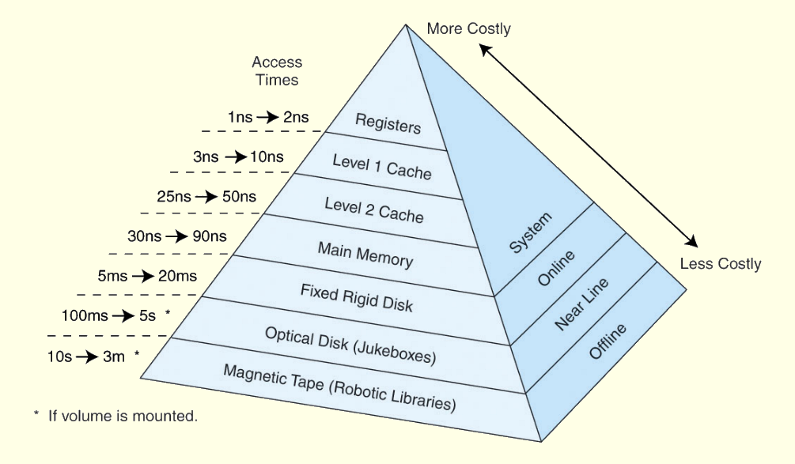
The Memory Hierarchy
This storage organization can be thought of as a pyramid:

